Slide 1


IE 7275: DATA MINING IN ENGINEERING GROUP 5: CASE STUDY Music Genre Classification and Recommendation
Guided By: Prof. Xuemin Jin
Group Members:
Anjali Kshirsagar
Saurabh Sonawane

Slide 2
Problem Definition
The widespread adoption of the Internet has brought about substantial changes in the music industry, including the widespread use of online music listening and sales platforms such as Spotify, Apple Music, YouTube Music, and SoundCloud.
These platforms enable individuals to access millions of songs from any location and at any time, greatly impacting the way people consume music.
To address the growing trend of music being shared and distributed online, the ability to categorize music into different genres has become increasingly important as it helps users discover new music and find specific types of music they are interested in.
In this project, we take a unique approach to music recommendations and genre classification, involving the use of acoustic features extracted from raw music through digital signal processing methods to make predictions, without considering the user's music profile.

Slide 3
Data set
Dataset Source
Kaggle : https://www.kaggle.com/datasets/andradaolteanu/gtzan-dataset-music-genre-classification
Dataset Description:
The dataset, known as the GTZAN Genre Dataset, encompasses 1000 audio tracks, each lasting 3 and 30 seconds. It encompasses 10 distinct genres: Blues, Classical, Country, Disco, Hiphop, Jazz, Metal, Pop, Reggae, and Rock, each with 100 tracks. The audio files are 22050 Hz Mono, 16-bit .wav format
Overview of dataset:
Number of records: 9990 rows × 60 columns
Number of features: 56
Quality
Missing values: None
Outliers: Harmony_mean, and perceptr_mean were removed since they had 21.7% and 14.6% outliers respectively after determining the measure of spread using the inter-quartile range

Slide 4
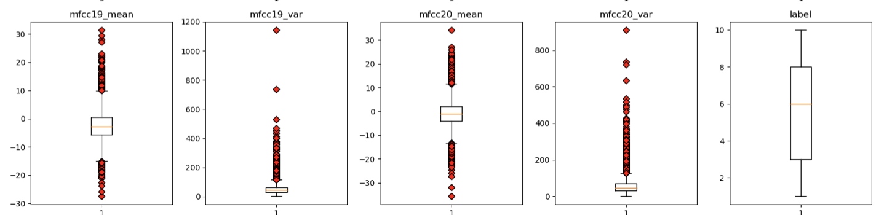
Data preprocessing/exploration/visualization:
Outliers
Harmony_mean, and perceptr_mean were removed since they had 21.7% and 14.6% outliers respectively after determining the measure of spread using the inter-quartile range

Slide 5
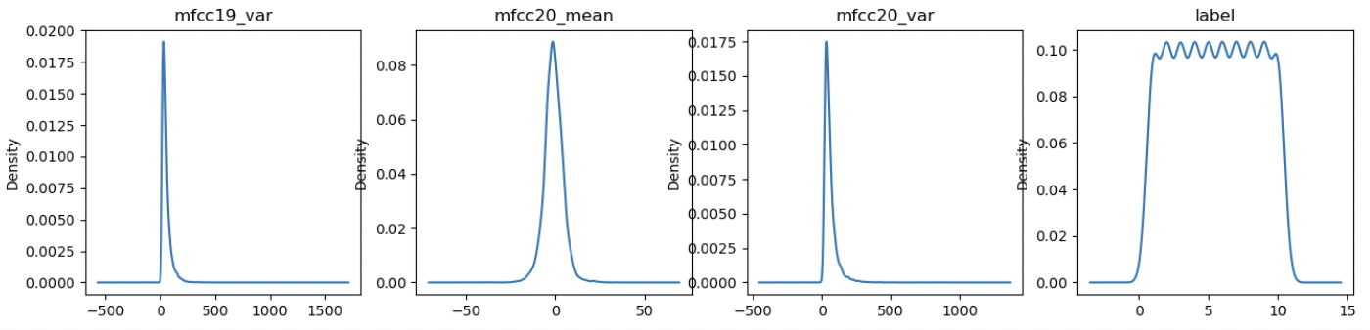
Data preprocessing/exploration/visualization:
Univariate distribution of Variables
Variables are Uniformly distributed

Slide 6
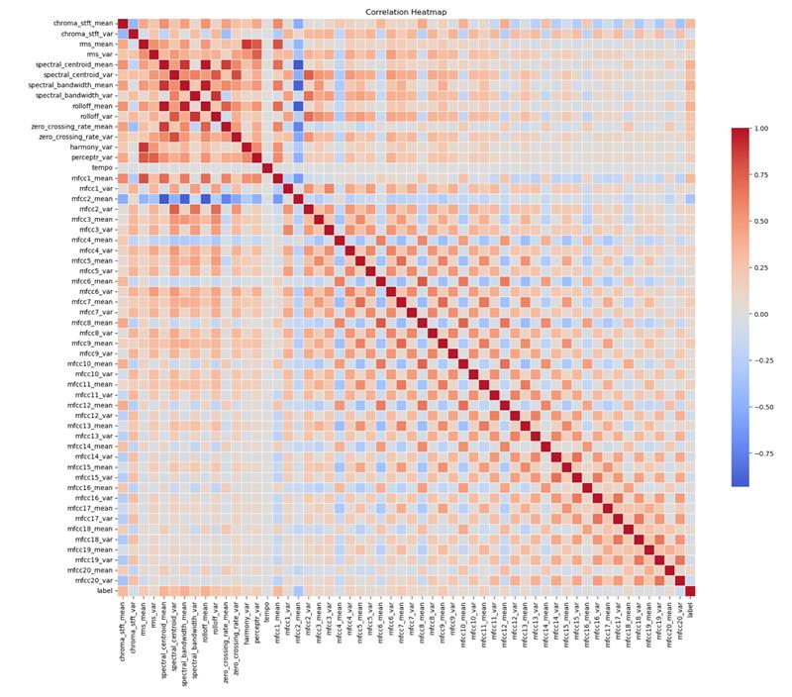
Data preprocessing/exploration/visualization:
Correlation Matrix
chroma_stft_mean chroma_stft_mean 1.000000
spectral_centroid_mean rolloff_mean 0.974360
spectral_bandwidth_mean rolloff_mean 0.951000
spectral_bandwidth_var rolloff_var 0.891339
spectral_centroid_mean spectral_bandwidth_mean 0.890382
rms_mean harmony_var 0.884846
spectral_centroid_mean zero_crossing_rate_mean 0.865487
spectral_centroid_var zero_crossing_rate_var 0.818348
rms_mean mfcc1_mean 0.795000
spectral_centroid_var rolloff_var 0.780308
mfcc6_mean mfcc8_mean 0.769248
rms_mean perceptr_var 0.766446
rolloff_mean zero_crossing_rate_mean 0.755442
spectral_centroid_var mfcc2_var 0.748612
rms_var perceptr_var 0.744850

Slide 7
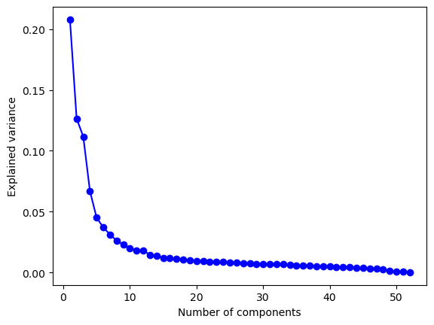
Dimension reduction
Principal Component Analysis
Principal Component Analysis (PCA) is a statistical technique used for reducing the dimensionality of a dataset while retaining as much of its variation as possible. It involves transforming a set of correlated variables into a new set of uncorrelated variables, called principal components, that explain the maximum variance in the data.

Slide 8
Machine learning models:
We used 6 machine models :
KNN
Naïve Bayes
Classification Trees/Random Forest/Boosted Trees
Logistic Regression
Linear Discriminant Analysis
Support vector machine

Slide 9
Machine learning models:
KNN Metrics:
Accuracy: 0.7542033626901521
Precision: 0.7565015142530416
Recall: 0.7536721621063449
F1 Score: 0.7525810917333915
Naive Bayes Metrics:
Accuracy: 0.5080064051240992
Precision: 0.5124889572361159
Recall: 0.5076167224480791
F1 Score: 0.49740054096644243
Random Forest Metrics:
Accuracy: 0.7473979183346677
Precision: 0.7442217437002123
Recall: 0.74659059885294
F1 Score: 0.7434728167345898
Logistic Regression Metrics:
Accuracy: 0.5580464371497198
Precision: 0.5427685554348939
Recall: 0.5578982071802217
F1 Score: 0.5452757366961637
LDA Metrics:
Accuracy: 0.5140112089671738
Precision: 0.499205988470639
Recall: 0.5146451171993276
F1 Score: 0.4956494369411583
SVM Metrics:
Accuracy: 0.6929543634907926
Precision: 0.6893256219425539
Recall: 0.6929270675718822
F1 Score: 0.6897739401721037

Slide 10
Performance comparison
Performance was calculated based on Accuracy, Precision, Recall and F1 Score
Both gains charts (also known as decile lift charts) and ROC curves are tools used in binary classification to evaluate the performance of a predictive model.
For multiclass classification, we can use a modified version of the gains chart called the cumulative response chart (CRC) or cumulative lift chart.

Slide 11
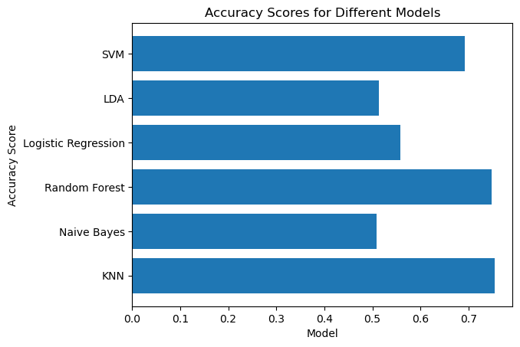
Performance comparison
Accuracy

Slide 12
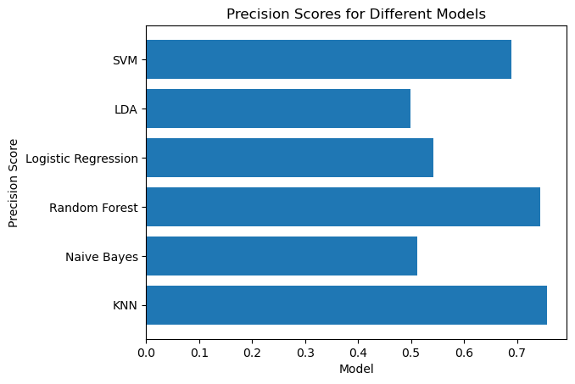
Performance comparison
Precision

Slide 13

Performance comparison
Recall

Slide 14

Performance comparison
F1-score

Slide 15
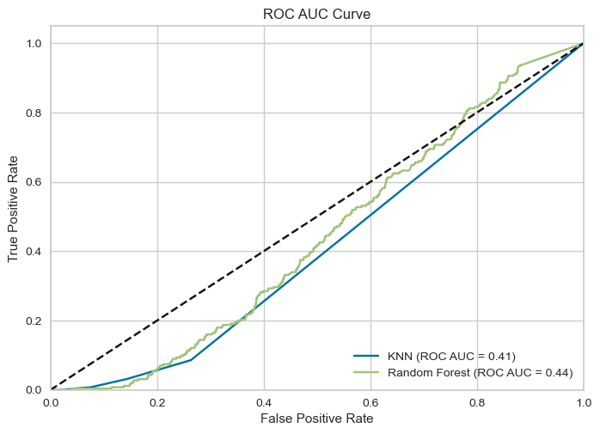
Performance comparison
ROC AUC Curve

Slide 16
Performance comparison
Based on the provided metrics, both the KNN and Random Forest models seem to have performed similarly with the KNN model having slightly better accuracy, precision, recall, and F1 score values than the Random Forest model. However, the difference in performance is relatively small and may not be statistically significant.
When choosing between the two models, other factors such as interpretability, scalability, and computational requirements should also be considered. KNN is a relatively simple and interpretable model that can be effective for small datasets, while Random Forest is a more complex and computationally intensive model that can handle larger datasets and high-dimensional feature spaces.
Therefore, the choice between KNN and Random Forest should depend on the specific requirements of the problem at hand and the characteristics of the dataset being used.

Slide 17
Conclusion
Music genre classification is an important task in the music industry, as it can help music enthusiasts discover new artists and compositions, as well as assist in narrowing down choices when searching for music that matches their current mood or taste.
The use of machine learning models such as KNN, Naïve Bayes, Classification Trees/Random Forest/Boosted Trees, Logistic Regression, Linear Discriminant Analysis, and Support Vector Machine, along with dimensionality reduction techniques such as PCA, can help improve the accuracy and efficiency of music genre classification systems.
The success of music genre classification systems heavily relies on the quality and relevance of the data used for training the models. Therefore, continued efforts should be made to collect and curate high-quality music datasets that represent diverse and evolving musical genres.

